Slide 1
Review: String
Array of char
char str[100]=“Hello”;// can only store str with max length 99
End with ‘\0’
scanf()/printf() “%s” //cannot read in space
fgets(str,100,stdin); //can read in space
<string.h> functions
strlen(s), strcpy(s1,s2), strcat(s1,s2)
strcmp(s1,s2) + 0 –
ASCII code

Slide 2
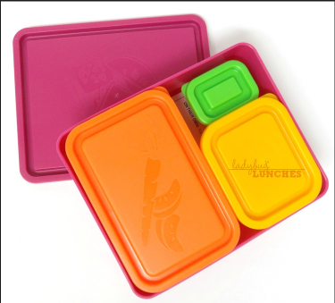
Structures
struct student { char id[11]; char name[40]; double gpa; };
Structure
Storage elements

Slide 3
Outline
Introduction
Syntax
Defining a structure
Accessing members of a structure
typedef
Syntax
Passing structures to a function
Returning a structure from a function

Slide 4
1. Introduction
A structure is a collection of related storage elements under a single name.
The elements in a structure can be of different types.
All elements in a structure are typically related semantically.
struct student { char id[11]; char name[40]; double gpa; };
Structure
Storage elements
Image src: http://www.ladybug-lunches.com/2013/07/bento-buddies-review.html

Slide 5
1.1. Defining a Structure Type (Syntax)
struct struct_name {
type1 member1;
type2 member2a, member2b;
…
typeN memberN;
} ;
struct student { char id[11]; char name[40]; double gpa; };
Define what kinds of data to hold.
A structure type is a defined using the keyword struct.
We need to define a structure type before we can declare variables of that type to store values.

Slide 6
1.1. Defining a Structure Type
An example:
This defines a new data type called struct student, which consists of three related members: id, name, and gpa.
/* define a NEW type for storing data LATER */
struct student {
char id[11];
char name[40];
double gpa;
};
Note the semicolon (;) at the end.

Slide 7
1.1. Defining a Structure Type
Important:
This defines only a new data type called struct student.
No variable storage has YET been allocated.
This is just the blueprint (design) of the new type.
/* define a NEW type for storing data LATER */
struct student {
char id[11];
char name[40];
double gpa;
};

Slide 8
1.1. Defining a Structure variables
Structure variables can then be declared just like variables of simple data types.
E.g.,
struct student peter;
struct student { char id[11]; char name[40]; double gpa; };
This is the type name.
This is the variable name.
peter
id
?
?
?
?
?
?
?
?
0
?
?
?
name
?
?
?
?
?
?
?
?
?
?
?
…
?
?
?
?
gpa
???

Slide 9
1.1. Altogether: Global Structure Type
A struct type is usually defined outside any functions.
#include <stdio.h>
/* define a NEW type for storing data LATER */
struct student {
char id[11];
char name[40];
double gpa;
};
int main() {
/* a variable declaration using the NEW type*/
struct student peter;
int no_of_students;
...
}
Global
scope
Local
variable

Slide 10
1.2. More Structure Examples
2D Coordinates
struct coord2D {
double x;
double y;
};
Employee record
struct employee {
char name[50];
double salary[12];
double MPF_contrib;
};
Quadratic form Ax²+Bx+C
struct quad_form {
double A, B, C;
};
Polynomial Ax^{n}+Bx^{n-1}+…+E
struct polynomial {
int degree;
double coeff[10];
};

Slide 11
1.3. Accessing struct Members
The Member Operator:
Members of a struct variable can be accessed using the member operator, i.e. the DOT .
For example, variable.member = 999;
where variable is a struct variable and member is a defined component of the struct.
struct student { char id[11]; char name[40]; double gpa; };
struct student peter;
peter.gpa = 3.28;

Slide 12
1.3. Accessing struct Members
The previous example:
struct student { char id[11]; char name[40]; double gpa; };
int main() {
struct student peter;
peter.gpa = 3.28;
…
}
peter
id
?
?
?
?
?
?
?
?
0
?
?
?
name
?
?
?
?
?
?
?
?
?
?
?
…
?
?
?
?
gpa
3.28

Slide 13
1.4. Another Example
1
2
3
4
5
6
7
8
9
10
11
12
13
14
15
16
17
struct date {
int day, month, year;
};
int main(void) {
struct date d1, d2;
// Assign 3 to the
// member "day" of d1
d1.day = 3;
// Assign 2023 to the
// member "year" of d2
d2.year = 2023;
return 0;
}
Defining a new structure type named date.
In this definition, we specify that each "value" of this type contains three members (day, month, and year) which are of type int.

Slide 14
1.4. Another Example
At line 6, we declare two variables, d1 and d2, of type "struct date".
1
2
3
4
5
6
7
8
9
10
11
12
13
14
15
16
17
struct date {
int day, month, year;
};
int main(void) {
struct date d1, d2;
// Assign 3 to the
// member "day" of d1
d1.day = 3;
// Assign 2023 to the
// member "year" of d2
d2.year = 2023;
return 0;
}
d1
day
?
month
?
year
?
d2
day
?
month
?
year
?
Each variable of type "struct date" has its own members.
Initially the members are uninitialized.

Slide 15
1.4. Another Example
1
2
3
4
5
6
7
8
9
10
11
12
13
14
15
16
17
struct date {
int day, month, year;
};
int main(void) {
struct date d1, d2;
// Assign 3 to the
// member "day" of d1
d1.day = 3;
// Assign 2023 to the
// member "year" of d2
d2.year = 2023;
return 0;
}
d1
day
3
month
?
year
?
d2
day
?
month
?
year
?
The dot operator (.) is called a member selection operator.
d1.day means "select the member day of d1".

Slide 16
1.4. Another Example
1
2
3
4
5
6
7
8
9
10
11
12
13
14
15
16
17
struct date {
int day, month, year;
};
int main(void) {
struct date d1, d2;
// Assign 3 to the
// member "day" of d1
d1.day = 3;
// Assign 2023 to the
// member "year" of d2
d2.year = 2023;
return 0;
}
d1
day
3
month
?
year
?
d2
day
?
month
?
year
2023
A member of type int is just like a regular variable of type int. Any syntax that is valid for a variable of type int is also valid for a member of type int.

Slide 17
1.4. Accessing struct Members (Another Example)
1
2
3
4
5
6
7
8
9
10
11
12
13
14
15
16
17
1819
struct date { int day, month, year; };
int main(void) {
struct date today, dob;
today.day = 10;
today.month = 11;
today.year = 2025;
printf("Date of birth (dd mm yyyy)? ");
scanf("%d%d%d", &dob.day, &dob.month, &dob.year);
if (today.month > dob.month ||
(today.month == dob.month && today.day >= dob.day))
printf( "Age = %d\n", today.year - dob.year );
else
printf( "Age = %d\n", today.year - dob.year - 1 );
return 0;
}
today
dob
day
3
day
?
month
4
month
?
year
2023
year
?
Calculate the age.

Slide 18
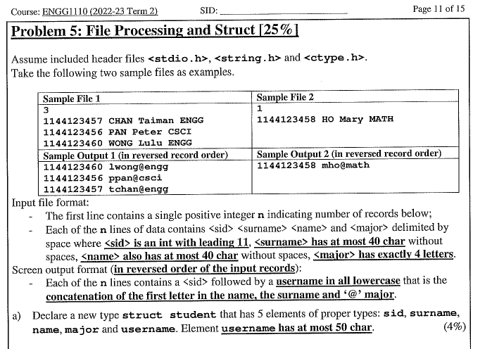
Ureply:

Slide 19
1.5. Initializing Structures
struct variables can be initialized as follows:
If there are not enough initializers, values of the remaining members are assigned zero by default, similar to array initialization.
struct date today = {3, 4};
/* today.year is assigned 0 implicitly */
today
struct date {
int day, month, year;
};
int main() {
struct date today = {3, 4, 2023} ;
…
}
day
3
month
4
year
2023
today
day
3
month
4
year
0

Slide 20
1.5. Initializing Structures
In some C compilers, the initializers can only be constant values or constant expressions.
No variables should be involved in the initializer expressions.
However, this can be allowed some other C compilers.
struct date {
int day, month, year;
};
int main() {
int i = 2023;
/* Var i allowed in some C compilers */
struct date today = { 3, 4, i };
…
}

Slide 21
1.5. Initializing Structures (More Examples)
struct employee {
char name[50];
double salary[12];
double MPF_contrib;
};
struct employee peter = {
"Peter Pan",
{ 9500, 9500, 10000, 11000, 12000, 12050,
12100, 13000, 13000, 13000, 14000, 14000},
0.05
};

Slide 22
1.6. Assignment of Structures
struct date { int day, month, year; };
struct date d1, d2 = { 1, 1, 2023 };
d1 = d2; // Copy d2 to d1 (all data byte by byte)
A struct value can be copied using the assignment operator.
Every member is copied, even for array.

Slide 23
1.6. Assignment of Structures
The assignment operator = can be applied to structure variables.
Individual member of the source structure is copied to the corresponding member of the target structure.
This applies even to array members in the structure, i.e., it also makes a copy of the array member inside the structure.
Structure assignment (COPYING and PASSING) consumes computing TIME, but it's CONVENIENT!

Slide 24
1.6. Assignment of Structures
1
2
3
4
5
6
7
8
9
10
11
12
13
14
15
16
17
18
19
20
#include <stdio.h>
#define NAMEMAX 30
struct student { char name[NAMEMAX+1]; int birth[3]; };
int main() {
struct student stu1={"Peter", {2006,3,27}};
struct student stu2;
stu2 = stu1; /* Structure assignment */
printf("student 1: %s Birth date %d %d %d\n", stu1.name,
stu1.birth [0], stu1.birth [1], stu1.birth [2]);
printf("student 2: %s Birth date %d %d %d\n", stu2.name,
stu2.birth [0], stu2.birth [1], stu2.birth [2]);
return 0;
}
Define macro (宏) with constant value -> used in project
This is a trick to have “changeable” array size!
Copy all members
Even for the array
student 1: Peter Birth date 2006 3 27
student 2: Peter Birth date 2006 3 27
Notes:
In C programming, #define is a preprocessor directive that is used to define macros, which are the identifiers defined by #define which are replaced by their value before compilation.
One typical use of #define is to define constants.

Slide 25
1.7. Defining an alias to an existing data type
We can introduce an alias to an existing data type using typedef.
Syntax
typedef existing_type_name alias;
After the declaration, both alias and existing_type_name refer to the same data type.
typedef struct student Stu_t;

Slide 26
1.7. Defining an alias to an existing data type
struct date {
int day, month, year;
};
typedef struct date Date;
// From this point onward,
// "Date" becomes an alias of
// "struct date"
int main(void) {
Date d1, d2;
struct date d3;
// The types of d1, d2, and
// d3 are the same
...
}
struct date {
int day, month, year;
};
int main(void) {
struct date d1, d2;
...
}
Do not add the keyword struct in the front.

Slide 27
1.7. Combining typedef with structure definition
struct date {
int day, month, year;
};
typedef struct date Date;
Defining a struct type named "date" and defining an alias to the struct type in two separate declarations.
int main(void) {
Date d1, d2;
struct date d3;
}

Slide 28
1.7. Combining typedef with structure definition
struct date {
int day, month, year;
};
typedef struct date Date;
Defining a struct type named "date" and defining an alias to the struct type in two separate declarations.
equivalent to
Defining a struct type named "date" and defining an alias to the struct type in one declaration.
typedef struct date {
int day, month, year;
} Date;
int main(void) {
Date d1, d2;
struct date d3;
}

Slide 29
1.7. Combining typedef with structure definition
struct date {
int day, month, year;
};
typedef struct date Date;
Defining a struct type named "date" and defining an alias to the struct type in two separate declarations.
equivalent to
Defining a struct type named "date" and defining an alias to the struct type in one declaration.
typedef struct date {
int day, month, year;
} Date;
almost equivalent to
typedef struct {
int day, month, year;
} Date;
Defining a struct type with no name and defining an alias to the struct type in one declaration.
With the first two approaches, the type can be referred to in the program as "struct date" and "Date". With the 3rd approach, the type can only be referred to in the program as "Date".

Slide 30
1.7. Combining typedef with structure definition
With the first two approaches, the type can be referred to in the program as "struct date" and "Date".
struct date {
int day, month, year;
};
typedef struct date Date;
int main(void) {
Date d1, d2;
struct date d3;
}
equivalent to
typedef struct date {
int day, month, year;
} Date;
almost equivalent to
int main(void) {
Date d1, d2;
struct date d3;
}
typedef struct {
int day, month, year;
} Date;
With the 3rd approach, the type can only be referred to in the program as "Date".

Slide 31
1.7. More typedef examples
struct student {
char id[11];
char name[40];
double gpa;
}; /* A structure declaration */
typedef struct student STUDENT_t; /* An alias */
...
STUDENT_t peter; /* Declare variable peter */
Define STUDENT_t as an alias to struct student. This allows shorter type names.
STUDENT_t is also called a Type-Defined Structure.

Slide 32
Structure Basic
Defining
Initializing
Accessing struct Members
Assignment of Structures
typedef
#include <stdio.h>
typedef struct{ char name[40]; int birth[3]; }student;
int main() {
student stu1={"Peter", {2006,3}};
student stu2;
printf("student 1: %s date %d\n",
stu1.name, stu1.birth[2]);
stu2 = stu1;
return 0;
}

Slide 33
2. Structures and Functions
2.1. Structures as Function Parameters
2.2. Structures as Function Return Values
2.3. Structures as BOTH Function Parameters and Function Return Values
/* define a NEW type for storing rational number */
struct rational {
int num; // numerator
int den; // denominator
};

Slide 34


2.1. Structures as Function Parameters
struct rational
$\frac{\text{3}}{\text{10}}$
Rational (Fractional) Number
Form of $\frac{\text{numerator}}{\text{denominator}}$ , or
simply $\frac{\text{num}}{\text{den}}$ , where num and den are integers.
To simplify the example, we assume both num and den are positive integers.
Int num
Int den
double a=0.3;
printf("%.20f",a); 0.29999999999999998890
struct rational {
int num; // numerator
int den; // denominator
};

Slide 35
2. Structures and Functions
struct rational
2.1. Structures as Function Parameters
void func( struct rational rat )
2.2. Structures as Function Return Values
struct rational func( )
2.3. Structures as BOTH Function Parameters and Function Return Values
struct rational func( struct rational rat )
num
den
/* define a NEW type for storing rational number */
struct rational {
int num; // numerator
int den; // denominator
};

Slide 36
2.1. Structures as Function Parameters
1
2
3
4
5
6
7
8
9
10
11
12
13
14
15
16
17
18
19
20
21
22
23
24
#include <stdio.h>
/* Define the structure "rational" */
struct rational {
int num, den;
};
// A function for printing rational
void r_Print( struct rational rat ) {
printf("%d / %d", rat.num, rat.den);
}
int main() {
struct rational three_over_four = {3, 4};
r_Print( three_over_four ); // Function call
return 0;
}
struct rational
num
den
3 / 4
three_over_four
num
3
den
4

Slide 37
2.1. Structures as Function Parameters
1
2
3
4
5
6
7
8
9
10
11
12
13
14
15
16
17
18
19
20
21
22
23
24
#include <stdio.h>
/* Define the structure "rational" */
struct rational {
int num, den;
};
// A function for printing rational
void r_Print( struct rational rat ) {
printf("%d / %d", rat.num, rat.den);
}
// A function for obtaining real number
double r_Real( struct rational rat ) {
return (double)rat.num / rat.den;
}
int main() {
struct rational three_over_four = {3, 4};
double real_num;
r_Print( three_over_four ); // Function call
real_num = r_Real( three_over_four ); // Function call
printf(" = %f\n", real_num);
return 0;
}
struct rational
num
den
3 / 4
= 0.750000
three_over_four
num
3
den
4

Slide 38
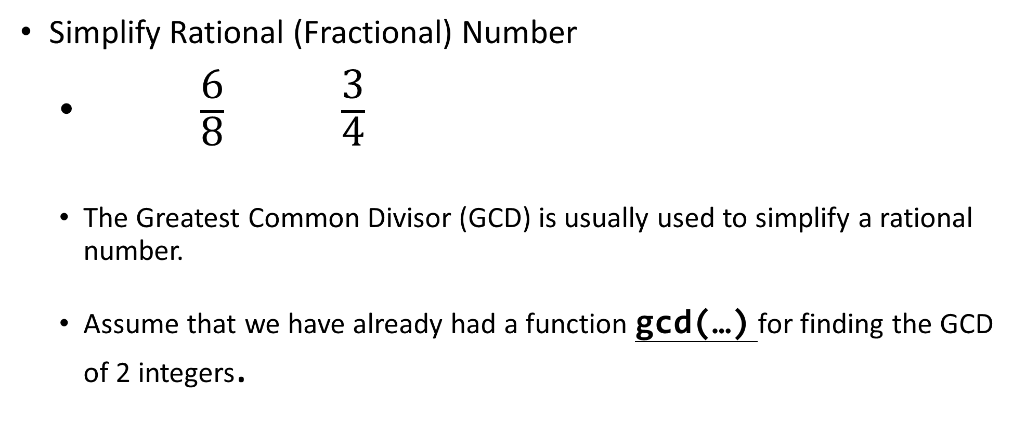
2.1. Structures as Function Parameters
struct rational
Simplify Rational (Fractional) Number
$\frac{\text{6}}{\text{8}}$ $\frac{\text{3}}{\text{4}}$
The Greatest Common Divisor (GCD) is usually used to simplify a rational number.
Assume that we have already had a function gcd(…) for finding the GCD of 2 integers.
num
den

Slide 39
2.2. Structures as Function Return Values
1
2
3
4
5
6
7
8
9
10
11
12
13
14
15
16
17
18
19
20
21
22
23
…… /* struct definition and r_Print same as before */
struct rational r_Create( int n, int d ) {
struct rational rat;
int g;
g = gcd(n, d); /* Assume existence of gcd() */
rat.num = n / g;
rat.den = d / g;
return rat;
}
int main() {
struct rational rat_num = {6, 8};
r_Print( rat_num );
printf(" --> ");
rat_num = r_Create(rat_num.num , rat_num.den ); /* rat_num is updated */
r_Print( rat_num );
return 0;
}
rat
num
6/2
den
8/2
rat_num
num
6
3
den
8
4
6 / 8
-->
3 / 4

Slide 40
2.3. Structures as BOTH Parameters and Return Values
1
2
3
4
5
6
7
8
9
10
11
12
13
14
15
16
17
18
19
20
21
22
23
… /* struct definition and other functions same as before */
typedef struct rational Rational; /* alias */
Rational r_Add( Rational rat1, Rational rat2 ) {
int num, den;
num = rat1.num * rat2.den + rat2.num * rat1.den;
den = rat1.den * rat2.den;
return r_Create( num, den );
}
int main() {
Rational six_over_eight, one_over_two;
six_over_eight = r_Create( 6, 8 );
r_Print( six_over_eight );
printf(" + ");
one_over_two = r_Create( 1, 2 );
r_Print( one_over_two );
printf(" = ");
r_Print( r_Add( six_over_eight, one_over_two ) );
return 0;
}
six_over_eight
one_over_two
+
num
6
num
1
den
8
den
2
3 / 4
+
1 / 2
=
5 / 4

Slide 41
3. More Structures
3.1. Array in Structures
struct student { char name[NAMEMAX+1]; int birth[3]; };
3.2. Array of Structures
struct student student_list[100];
3.3. Nested Structures
struct student {
char name[30];
struct date dob;
}
struct date {
int day, month, year;
};

Slide 42
3.1. Array Members in Structures
1
2
3
4
5
6
7
8
9
10
11
12
13
14
15
16
17
18
19
20
21
22
#include <stdio.h>
#define NAMEMAX 100
struct student { char name[NAMEMAX+1]; int birth[3]; };
int main() {
struct student stu1 = {"Peter", {2006,3,27}};
struct student stu2;
printf("Your name? ");
scanf("%s", stu2.name);
printf("Your birth year? ");
scanf("%d", &stu2.birth[0]);
return 0;
}
/* Define the type struct person */

Slide 43
3.1. Array Members in Structures
struct student { char name[NAMEMAX+1]; int birth[3]; };
Entities | Meaning/ Description | Type/ Value
stu1 | The whole structure | struct student
stu1.name | The whole string member name | char [] “Peter"
stu1.name[0] | The 1st character of string stu1.name | char ‘P'
stu1.birth | The whole integer array member | int []
stu1.birth[1] | The 2nd integer in stu1.birth | int 3
struct student stu1 = {"Peter", {2006,3,27}};

Slide 44
3. More Structures
3.1. Array in Structures
struct student { char name[NAMEMAX+1]; int birth[3]; };
3.2. Array of Structures
struct student student_list[100];
3.3. Nested Structures
struct student {
char name[30];
struct date dob;
}
struct date {
int day, month, year;
};

Slide 45
3.2. Array of Structures
Structures may occur as an array.
Example:
struct student { char name[NAMEMAX+1]; int birth[3]; // {year, month, date}
int mark; };
int main(void) {
struct student student_list[100];
student_list[0].mark = 98; // mark of the 1st student ← 98
// check the second integer(month) of birth of the 11th student
if ( student_list[10]. birth[1] == '11' )
printf(“Happy Birthday");
return 0;
}
1
2
3
4
5
6
7
8
9
10
11
12
13
14
15
16

Slide 46
3.2. Array of Structures
array variable student_list
student_list[0]
student_list[1]
…
student_list[99]
name[]
name[]
name[]
…
birth[]
birth[]
birth[]
mark
mark
mark
Entities | Meaning/ Description
student_list | An array of struct student
student_list[2] | The 3rd student element of the array, a variable of type struct student
student_list[i].name | The name of the (i+1)^{th} student in the array, a string
student_list[i].name[j] | The (j+1)^{th} character of the name of the (i+1)^{th} student in the array, a single char

Slide 47
3. More Structures
3.1. Array in Structures
struct student { char name[NAMEMAX+1]; int birth[3]; };
3.2. Array of Structures
struct student student_list[100];
3.3. Nested Structures
struct student {
char name[30];
struct date dob;
}
struct date {
int day, month, year;
};

Slide 48
3.3. Nested Structures
1
2
3
4
5
6
7
8
9
10
11
12
13
14
15
16
17
18
19
20
#include <stdio.h>
#define NAMEMAX 100
struct date {
int day, month, year;
};
struct student { char name[NAMEMAX+1]; struct date dob; };
int main() {
struct student stu1 = {"Peter", {27,3,2006}};
struct student stu2;
printf("Your birth year? ");
scanf("%d", &stu2.dob.year);
return 0;
}
/* Define the type struct person */

Slide 49
3.4. Nested Structures (Another Example)
1
2
3
4
5
6
7
8
9
10
11
12
13
14
15
16
#include <stdio.h>
#include <string.h>
struct date {
int day, month, year;
};
struct book {
char author[30];
char title[50]
char publisher[30];
int edition;
struct date date_of_pub;
};
booklist[0]
author
Al Kelley, Ira Pohl
title
C By Dissection
publisher
Pearson
edition
4
date_of_pub
day
30
month
10
year
2000

Slide 50
3.4. Nested Structures Array(Another Example)
1
2
3
4
5
6
7
8
9
10
11
12
13
14
15
16
17
18
19
20
21
22
23
24
25
26
struct date {
int day, month, year;
};
struct book {
char author[30];
char title[50]
char publisher[30];
int edition;
struct date date_of_pub;
};
int main(void) {
struct book booklist[100];
strcpy( booklist[0].author, "Al Kelley, Ira Pohl" );
strcpy( booklist[0].title, "C By Dissection" );
strcpy( booklist[0].publisher, "Pearson" );
booklist[0].edition = 4;
booklist[0].date_of_pub.day = 30;
booklist[0].date_of_pub.month = 10;
booklist[0].date_of_pub.year = 2000;
...
booklist[0]
author
Al Kelley, Ira Pohl
title
C By Dissection
publisher
Pearson
edition
4
date_of_pub
day
30
month
10
year
2000
Multiple levels of dots!
Multiple levels of dots!

Slide 51
Summary
A structure is a means for a programmer to group related variables into one "container".
Each member of a structure is like a regular variable. Their main difference is in the syntax.
Syntax which you should remember
Defining a structure (with and without typedef)
Using structure and accessing members of a structure by the member operator “.”.
Structure assignment can potentially be expensive.
Structure values can be passed as function parameters and also returned from functions.
Structures can be members of other structures. (Nested structures)

Slide 52
Reading Assignment
C: How to Program, 8th ed, Deitel and Deitel
Chapter 10 C Structures
Sections 10.1 – 10.4: Structure Basics
Section 10.5: Using Structures with Functions
Section 10.6: typedef
Section 10.7: A Practical Example

